Slide 1
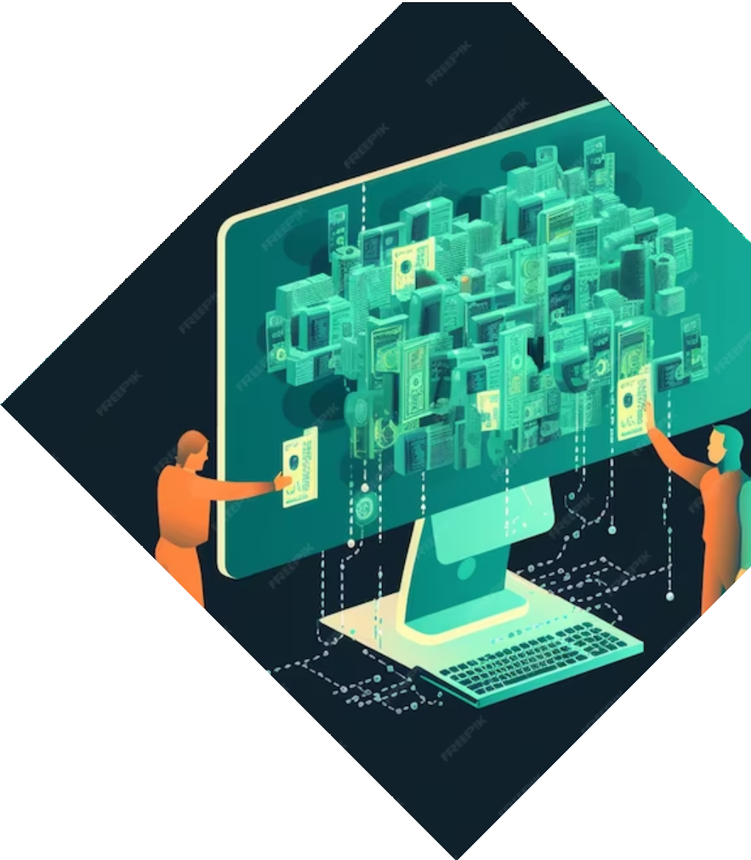

Maximizing Efficiency and Effectiveness: Exploring the Power of Oracle Database, User Interfaces, and CRUD Operations
Group 1 : Harish Rao Yadagiri
Anoop Garige Lakshmi Priya Chintada Sai Ramakanth Kodi

Slide 2

Introduction
Oracle Database is a multi-model database management system (DBMS) produced and marketed by Oracle Corporation. It is a relational database commonly used for running enterprise applications, with high availability, scalability, and performance.

Slide 3

Advantages of Oracle Database
Scalability
Security
High Availability
Advanced Analytics
Integration
Hybrid premise
Advanced Query
Optimization
Compatibility
Backup and Recovery
Enterprise Support
Warehousing

Slide 4

Optimizing User Interfaces
User Interface for Database Interaction: Creating an intuitive and user-friendly interface for interacting with the database.
SQL Developer Usage: Utilizing SQL Developer as the primary tool to connect to Oracle instances.
User Experience Design: Focusing on design considerations to enhance the overall user experience.
Optimizing Usability: Ensuring that the interface is designed for ease of use and efficient database management.

Slide 5
About the datasets
Dataset 1: Transaction_data.csv
To contain transaction records, each associated with a unique customer, and includes information such as the items purchased, the quantity, and the transaction timestamp. It also includes details about the items and the country where the transactions occurred.
Dataset 2: Customers.csv
It’s a dataset of customer profiles, including demographic information, income, spending behavior, and profession details.

Slide 6

Overview
Oracle database system for our transactions of customers :
Customer centric approach
Transactions Tracking
Real time data access and updates
Transactional design of our product:
Speed and efficiency
ACID compliance
The "transaction_data.csv" dataset holds transaction records, including IDs, item details, quantities, costs, and origin, enabling us to analyze customer purchase behavior and product performance. Meanwhile, "customer.csv" offers demographic data like age, gender, income, and profession, aiding in customer segmentation and tailored marketing.
Together, these datasets create a synergy that underpins our customer-centric e-commerce platform. This synergy facilitates personalized shopping experiences, product optimization, and a deeper understanding of customer behavior, contributing to our platform's success and growth.

Slide 7
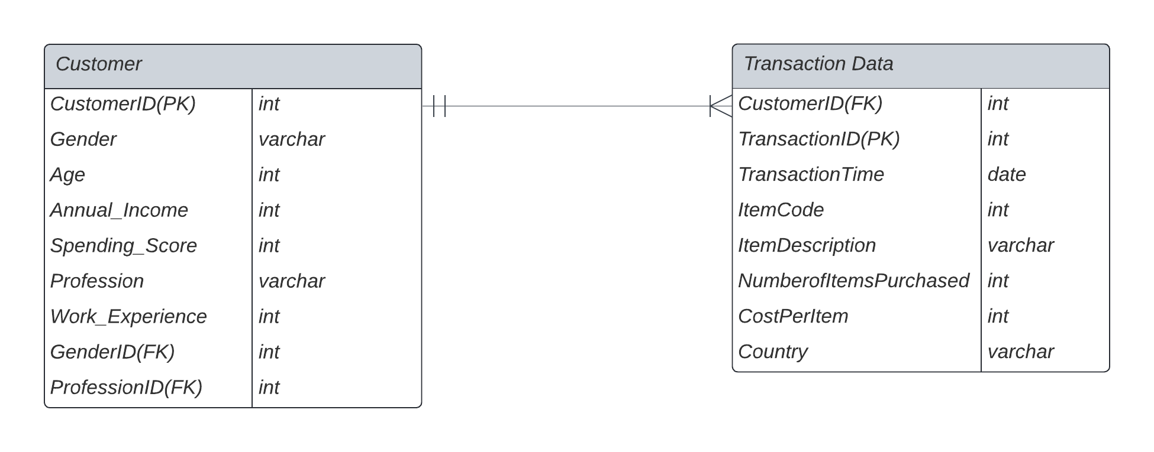
Schematic Diagram and ERD diagram
Database schema
Transaction Data
Tables
Customer
Transaction Data
Gender
Profession

Slide 8
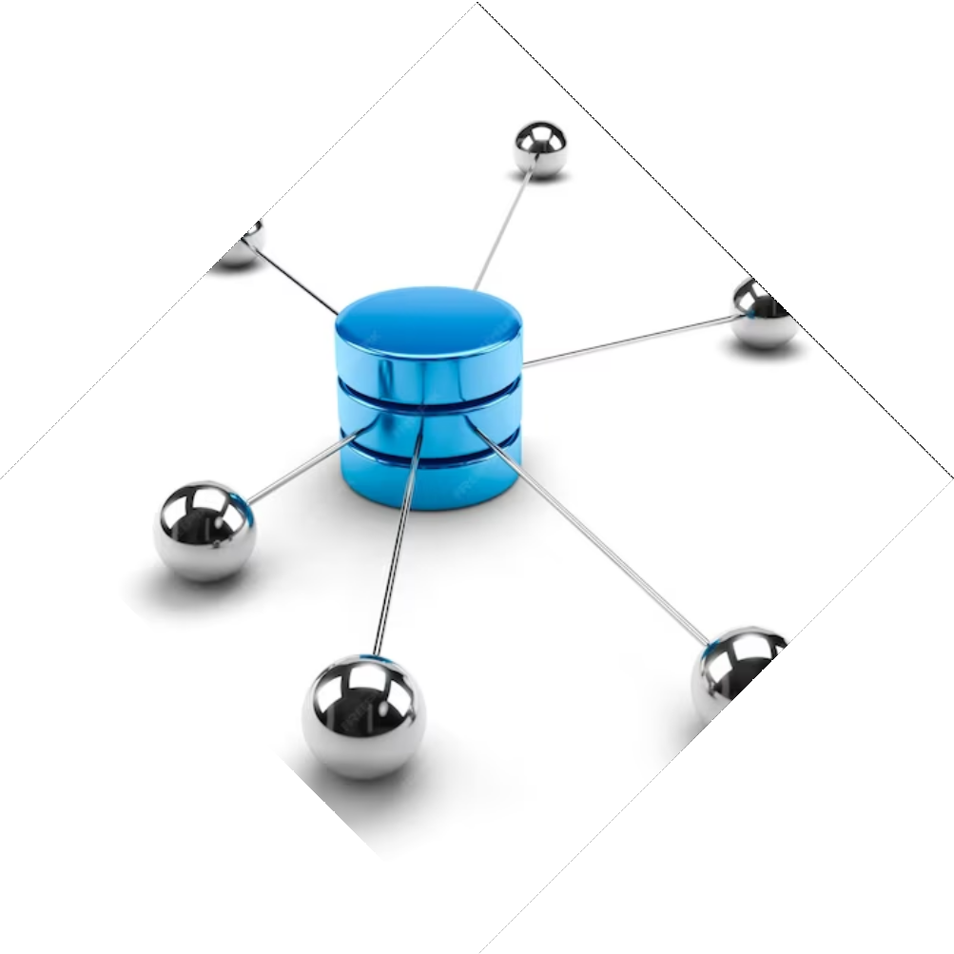
CRUD OPERATIONS
Create
Customer Profiles
Transaction Listings
Order Placement
Demographic Data
Read
Customer Profiles
Purchase Catalog
Transaction history
Market Segmentatation
Update
Customer information
Stock Management
Order processing
Delete
Account Deactivation
Product Discontinuation
Record Cleanup

Slide 9

CRUD OPERATIONS
Create (INSERT) Operation:
• MSSQL:
INSERT INTO TableName (Column1, Column2, ...)
VALUES (Value1, Value2, ...);
• Oracle:
INSERT INTO TableName (Column1, Column2, ...)
VALUES (Value1, Value2, ...);
Read (SELECT) Operation:
• MSSQL:
SELECT Column1, Column2, ...
FROM TableName
WHERE Condition;
• Oracle:
SELECT Column1, Column2, ...
FROM TableName
WHERE Condition;

Slide 10
CRUD OPERATIONS
Update (UPDATE) Operation:
• MSSQL (With "FROM" Clause for Join):
UPDATE t1
SET t1.Column1 = Value1, t2.Column2 = Value2
FROM TableName1 t1
JOIN TableName2 t2 ON t1.JoinColumn = t2.JoinColumn
WHERE Condition;
• Oracle (Using Subquery):
UPDATE TableName1 t1
SET t1.Column1 = Value1
WHERE t1.JoinColumn IN (SELECT t2.JoinColumn FROM TableName2 t2 WHERE Condition);
o Key Difference: In Microsoft SQL Server (MSSQL), you have the capability to directly join tables using the FROM clause within the UPDATE statement. This feature is not available in Oracle, where you typically rely on subqueries to accomplish similar updates.

Slide 11
Conclusion
Limitations:
Expensive Licensing: Oracle's licensing costs can be prohibitive for organizations with tight budgets.
Complexity: Oracle's complexity may present challenges for smaller teams or less experienced database administrators.
Advantages:
Reliability: Oracle is well-known for its reliability, ensuring data integrity and system uptime.
Scalability: It excels in handling large-scale and mission-critical applications seamlessly.
When to Use It:
Enterprise Applications: Oracle is an ideal choice for large enterprises with substantial IT budgets that require a highly reliable and scalable database.
Mission-Critical Systems: It is well-suited for systems where data security and availability are paramount, such as financial institutions and healthcare organizations.
In conclusion, Oracle is a robust database system, offering reliability and scalability but may not be the most cost-effective solution, making it best suited for larger enterprises and mission-critical applications where data integrity and system uptime are of utmost importance.

Slide 12
Teams Link: Call with DBMS project-20231108_230430-Meeting Recording.mp4

